Slide 1

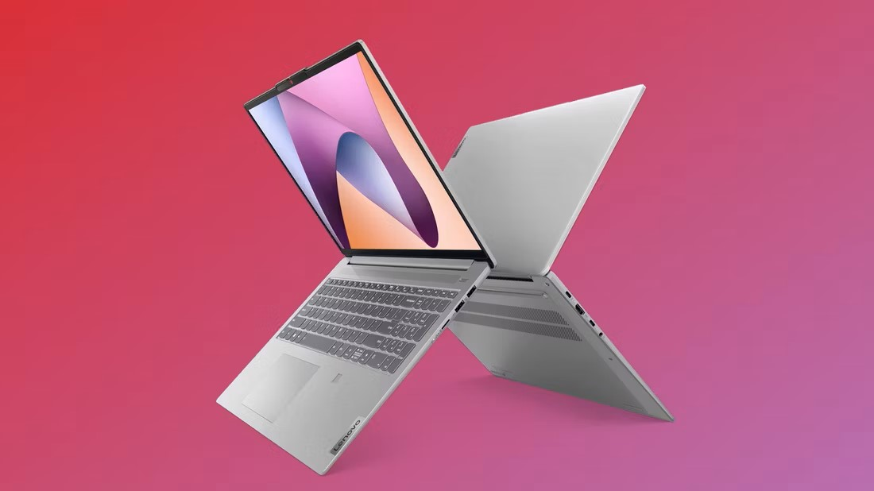

Consumer Decision-Making Analysis

Slide 2


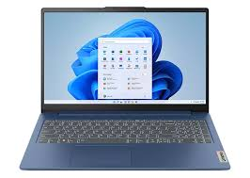
PRODUCT SELECTION LAPTOP
COMPANY:- LENOVO
STORAGE:- 1TB
COLOUR:-METALLIC

Slide 3
PARTICIPATION REFLECTION
Processor :- The Product would be to look for high quality innovative product with high processor.
New Technology :- It has all the major technology which I am looking in any laptop such as better performance, camera, look of the laptop like design, long lasting which forces more towards this latop as consumer.
Review :- I have also talk to my peers , family whether this phone is good or bad they have suggested that this has more reliable than any other laptop.
Design :- And at last it looks premium than others which help me to buy.

Slide 4
Factor Influencing Consumer Behavior
INTERNAL FACTOR
Uses :- I am using for both educational as well as personal use.
Perception :- Previously I want Mac but after knowing its after sales review I changed my mind.
Lifestyle :- From childhood we use window hence it is selected.
EXTERNAL FACTOR
Technological Factor:- using window previously
Social factor:- getting suggestion from family and friend
Economical factor:- price of other brand is high in related to my product

Slide 5
ANALYSIS OF DECISION OUTCOMES
Alignment with expectation :
Value for money :- I found Lenovo Ideapad is value for money in comparision of others.
Satisfaction :- I had my expectation set for the laptop regarding performance, features and lenovo has exceeded my expectations.
Unexpected factor :-
Faced issues :- I have faced issue in battery.
Reliability :- It has been more than 2 years since and it goes well.

Slide 6
RECOMMANDATIONS FOR FUTURE DECISION MAKING
Collecting information :- There should be collected information about the product and its competitions so that we compare them.
Long term consideration :-The Cost of laptop is not so low hence we keep in mind to use it for long term .
Stay informed :-As Lenovo have various showroom and store that informed us . Also various updates is coming for competing new software and malware.

Slide 7
THANK YOU

